Slide 1
Automated Restaurant Management System (ARMS)
Group Member: Muhammad Atif Bashir (16201519-009) Daud Rauf Butt (16201519-023)

Slide 2
Introduction
Automated Restaurant management system is the system for management of the restaurant business more efficiently. There is a need for an automated database management system because small-scale restaurant businesses are failing to compete with multi-national food chains and thus, local restaurants are going out of business due to poor management methods.

Slide 3
Features Our model can be seen in three perspectives or views and each is different from one another as it is the requirement of our organization to have separate interfaces for different types of users; namely manager view, employee view, and a customer view. The description of those three views, in detail, is as follows:
Manager View:
The manger will have his login details to access the system. The manager can view the record of all employees, hire/add a new employee to the system, and fire/remove an existing employee from the system. Moreover, the manager can view the inventory and update it too. The manager, can also generate reports on a weekly/monthly basis of employee attendance, orders placed, and expenditure.

Slide 4
Employee View:
Any employee that is registered by the manager, can logon to the system and will be redirected to the employee’s view. The employee can view his attendance details, look for inventory items, and also check the incoming orders and finish them when delivered.
Customer View:
A customer would first be required to register in the system, setting up his account by entering his personal information. Once, registered in the system, he can login to the system. After successfully logging in, the customer can now view the menu, from which he can place an order by selecting the desired items and their respective quantities. The selections would be added to a cart and a receipt will be generated on the screen, once the order is confirmed.

Slide 5
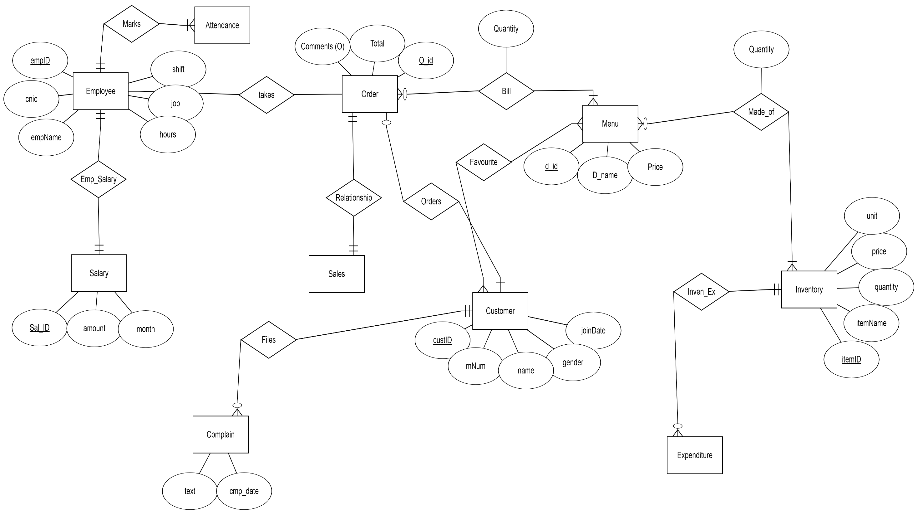

Slide 6
ERD Explanation
In our system, a customer may place order but and order must be placed by a customer. A customer can place many orders at different times when he visits multiple times. A customer also have no or more favorite menu items. An order have multiple or one item from menu list, which is used to generate a bill. Bill also have a quantity of the menu items in that particular order. Sales of the restaurant are related to the total orders placed. An order must belong to the sales. An employee of the restaurant takes order from the customer. Employee marks his attendance. Employee also have his salary. Customer can file a complaint about services by using his order id. Each item in the menu is made up of one or many items in the inventory. Items in the inventory are purchased from vender which is included in expenditures of restaurant.

Slide 7
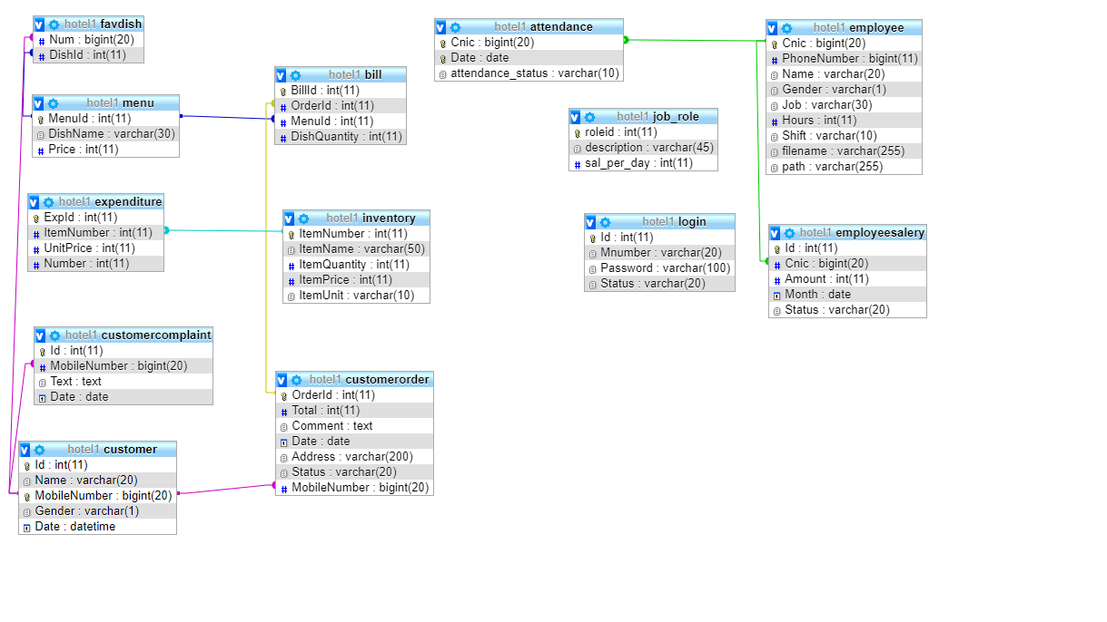

Slide 8
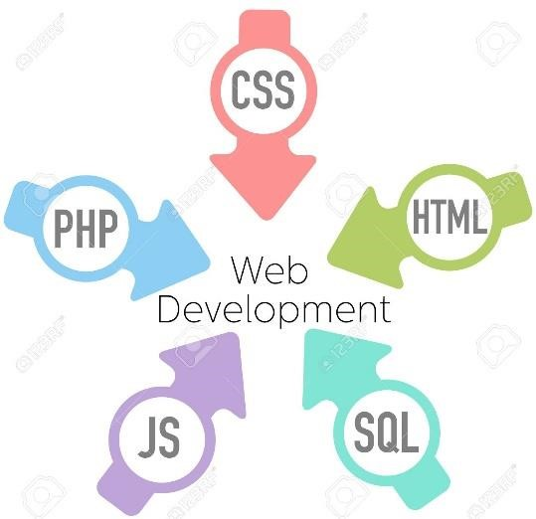


Tools and Languages Used

Slide 9
Now Without wasting time, Let’s move towards Project

Slide 10
You can visit website with following URL wwwarmscompk.000webhostapp.com
Register Yourself and enjoy our services

Slide 11
Thanks If anyone want to operate admin our employee panel he/she may come.

